Slide 1
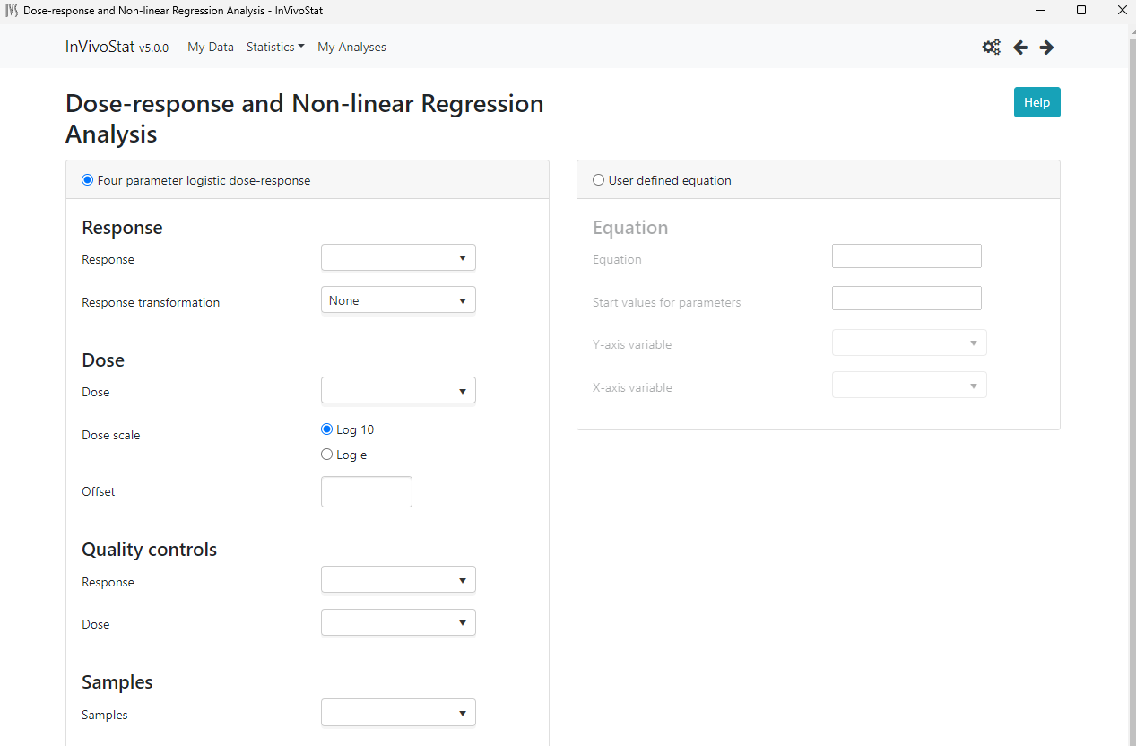
Weight
Drop down list: None (default)
1/Response
1/Response^2

